Slide 1
Software System Modeling

Slide 2

Agenda
Design patterns
Structural design patterns

Slide 3
Resources
Head First Design Patterns
https://refactoring.guru/design-patterns
https://mermaid-js.github.io/ - class diagrams

Slide 4
Design patterns

Slide 5
Design patterns are typical solutions to common problems in software design. Each pattern is like a blueprint that you can customize to solve a particular design problem in your code.
They define a common language that helps your team communicate more efficiently.
Criticism:
Inefficient solutions
Unjustified use

Slide 6
Clasification

Slide 7
Design patterns differ by their complexity, level of detail and scale of applicability to the entire system being designed.
The most basic and low-level patterns are often called idioms. They usually apply only to a single programming language.
The most universal and high-level patterns are architectural patterns. Developers can implement these patterns in virtually any language. Unlike other patterns, they can be used to design the architecture of an entire application. Ex: microservice architecture, hexagonal architecture, message brokers etc

Slide 8
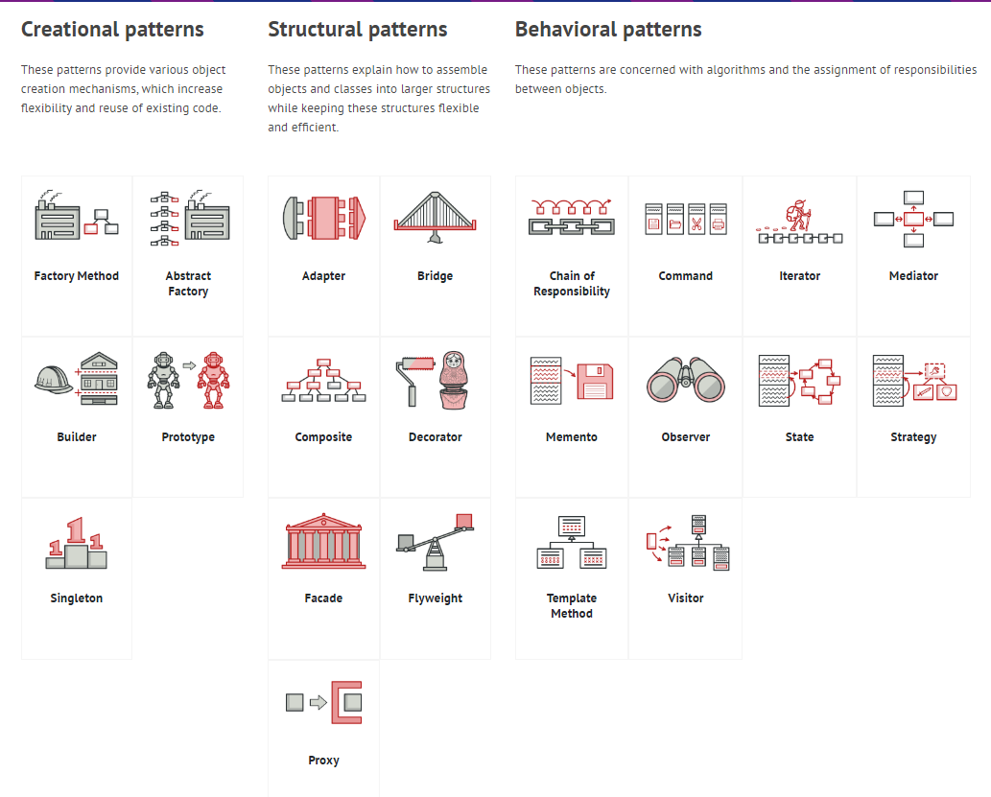

Slide 9
Singleton
Singleton is a creational design pattern that lets you ensure that a class has only one instance, while providing a global access point to this instance.

Slide 10
Problem
The Singleton pattern solves two problems at the same time:
Ensure that a class has just a single instance.
Provide a global access point to that instance.

Slide 11
Solution
All implementations of the Singleton have these two steps in common:
Make the default constructor private, to prevent other objects from using the new operator with the Singleton class.
Create a static creation method that acts as a constructor. Under the hood, this method calls the private constructor to create an object and saves it in a static field. All following calls to this method return the cached object

Slide 12
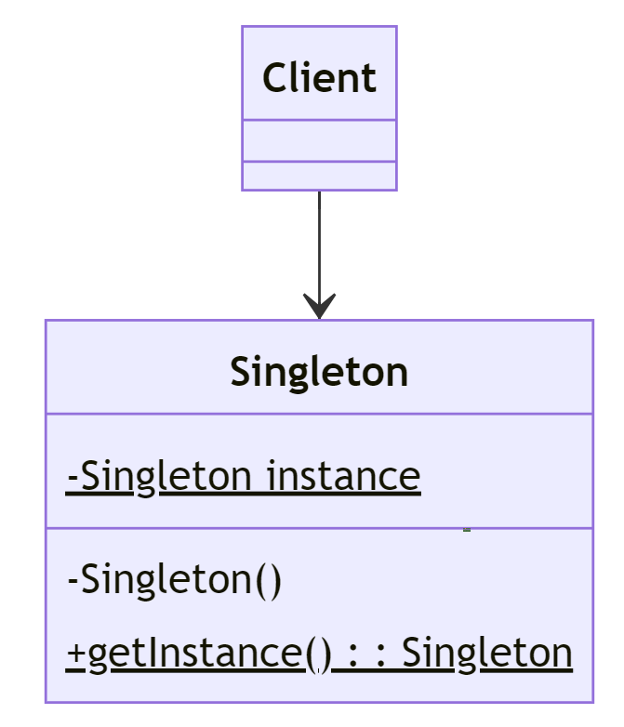

Slide 13
How to implement
Add a private static field for storing the singleton instance.
Declare a public static creation method for getting the singleton instance.
Implement “lazy initialization” inside the static method. It should create a new object on its first call and put it into the static field.
Make the constructor of the class private.
Go over the client code and replace all direct calls to the singleton’s constructor with calls to its static creation method.

Slide 14
Pros
Cons
You can be sure that a class has only a single instance.
You gain a global access point to that instance.
The singleton object is initialized only when it’s requested for the first time.
Violates the Single Responsibility Principle. The pattern solves two problems at the time.
The Singleton pattern can mask bad design, for instance, when the components of the program know too much about each other.
The pattern requires special treatment in a multithreaded environment so that multiple threads won’t create a singleton object several times.
It may be difficult to unit test the client code of the Singleton because many test frameworks rely on inheritance when producing mock objects. Since the constructor of the singleton class is private and overriding static methods is impossible in most languages, you will need to think of a creative way to mock the singleton. Or just don’t write the tests. Or don’t use the Singleton pattern.

Slide 15
Factory Method
Factory Method is a creational design pattern that provides an interface for creating objects in a superclass, but allows subclasses to alter the type of objects that will be created.

Slide 16
Problem
Imagine that you’re creating a logistics management application. The first version of your app can only handle transportation by trucks, so the bulk of your code lives inside the Truck class.
But what if you need to incorporate sea logistics into the app?
At present, most of your code is coupled to the truck class. Adding Ships into the app would require making changes to the entire codebase. Moreover, if later you decide to add another type of transportation to the app, you’ll probably need to make all of these changes again.

Slide 17
Solution
The Factory Method pattern suggests that you replace direct object construction calls with calls to a special factory method. Don’t worry: the objects re still created via the new operator, but it’s being called from within the factory method. Objects returned by a factory method are often referred to as products.

Slide 18
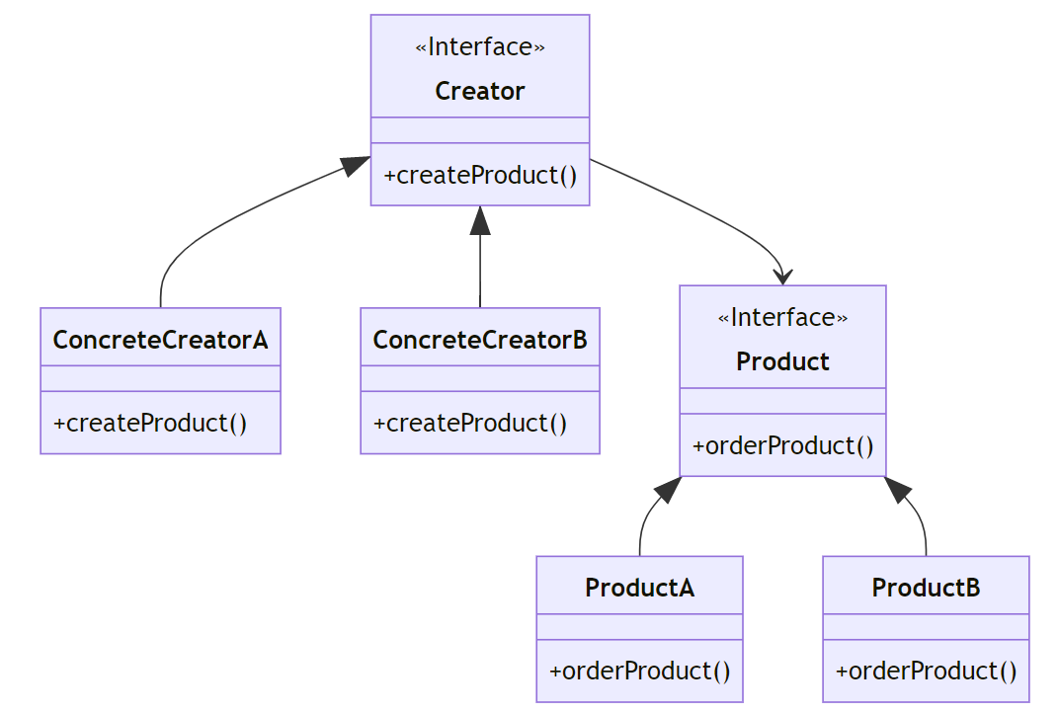

Slide 19
How to implement
Make all products follow the same interface.
Add factory method inside the creator class. The return type should match the common product interface
Create a set of creator subclasses for each type of product listed in the factory method.
If there are too many product types and it doesn’t make sense to create subclasses for all of them, you can reuse the control parameter from the base class in subclasses.

Slide 20
Pros
Cons
You avoid tight coupling between the creator and the concrete products.
Single Responsibility Principle. You can move the product creation code into one place in the program, making the code easier to support.
Open/Closed Principle. You can introduce new types of products into the program without breaking existing client code.
The code may become more complicated since you need to introduce a lot of new subclasses to implement the pattern. The best case scenario is when you’re introducing the pattern into an existing hierarchy of creator classes.

Slide 21
Abstract Factory
Abstract Factory is a creational design pattern that lets you produce families of related objects without specifying their concrete classes.

Slide 22
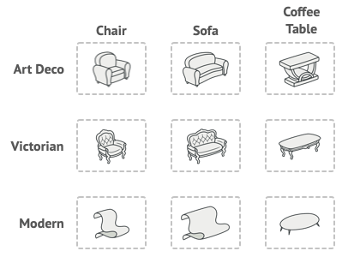
Problem
Imagine that you’re creating a furniture shop simulator. Your code consists of classes that represent a family of related products
You need a way to create individual furniture objects so that they match other objects of the same family. Customers get quite mad when they receive non-matching furniture.

Slide 23
Solution
The first thing the Abstract Factory pattern suggests is to explicitly declare interfaces for each distinct product of the product family (e.g., chair, sofa or coffee table).
Next move is to declare the Abstract Factory—an interface with a list of creation methods for all products, part of the product family (for example createChair, createSofa, createCoffeeTable).
For each variant of a product family, we create a separate factory class based on the AbstractFactory interface. For example ,the ModernFurnitureFactory can only create ModernChair, ModernSofa and ModernCofeeTable objects.

Slide 24
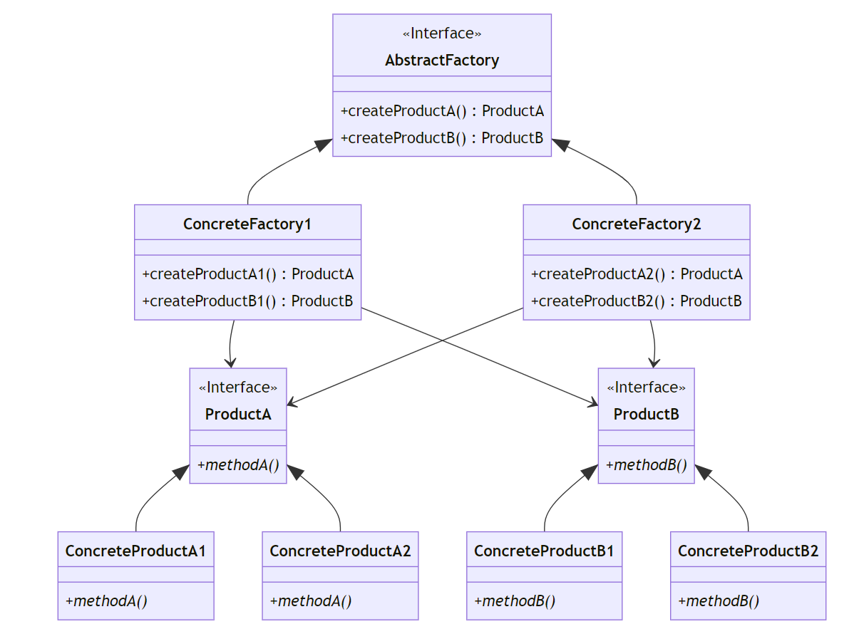

Slide 25
How to implement
Map out a matrix of distinct product types versus variants of these products.
Declare abstract product interfaces for all product types. Then make all concrete product classes implement these interfaces.
Declare the abstract factory interface with a set of creation methods for all abstract products.
Implement a set of concrete factory classes, one for each product variant.
Create factory initialization code somewhere in the app. It should instantiate one of the concrete factory classes, depending on the application configuration or the current environment. Pass this factory object to all classes that construct products.

Slide 26
Pros
Cons
You can be sure that the products you’re getting from a factory are compatible with each other.
You avoid tight coupling between concrete products and client code.
Single Responsibility Principle. You can extract the product creation code into one place, making the code easier to support.
Open/Closed Principle. You can introduce new variants of products without breaking existing client code.
The code may become more complicated than it should be, since a lot of new interfaces and classes are introduced along with the pattern.

Slide 27
Builder
Builder is a creational design pattern that lets you construct complex objects step by step. The pattern allows you to produce different types and representations of an object using the same construction code.

Slide 28
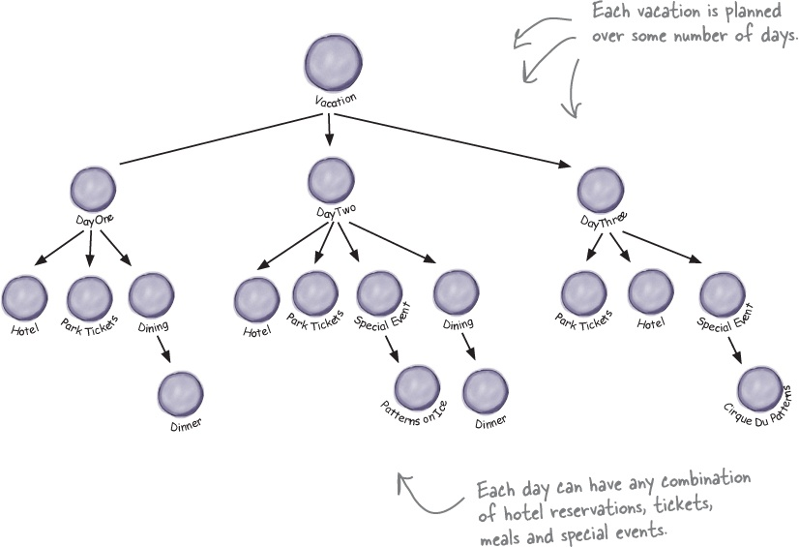
Problem
Imagine a complex object that requires laborious, step-by-step initialization of many fields and nested objects. Such initialization code is usually buried inside a monstrous constructor with lots of parameters. Or even worse: scattered all over the client code.

Slide 29
Solution
The Builder pattern suggests that you extract the object construction code out of its own class and move it to separate objects called builders.

Slide 30
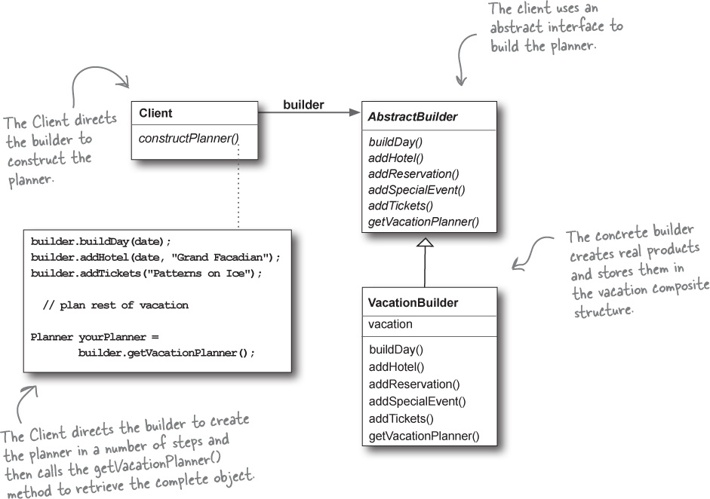

Slide 31
Director
You can go further and extract a series of calls to the builder steps you use to construct a product into a separate class called director. The director class defines the order in which to execute the building steps, while the builder provides the implementation for those steps.
Having a director class in your program isn’t strictly necessary. You can always call the building steps in a specific order directly from the client code. However, the director class might be a good place to put various construction routines so you can reuse them across your program.

Slide 32
How to implement
Create a concrete builder class for the product, having same attributes as the product.
Define setter methods for each of the field. Return this object instead of void for all setters.
Have a build method inside builder that instantiates the product class using all the attributes from builder.
Think about creating a director class. It may encapsulate various ways to construct a product using the same builder object.
The client code calls director class, if exists, otherwise uses builder in a method chaining to construct needed object.

Slide 33
Pros
Cons
You can construct objects step-by-step, defer construction steps or run steps recursively.
You can reuse the same construction code when building various representations of products.
Single Responsibility Principle. You can isolate complex construction code from the business logic of the product.
The overall complexity of the code increases
Some implementations of Builders are great examples of Feature Envy or God Class code smells.

